Slide 1
Rising Star Update
Lin, Yuchen, Chengxi
Aug 22, 2017

Slide 2
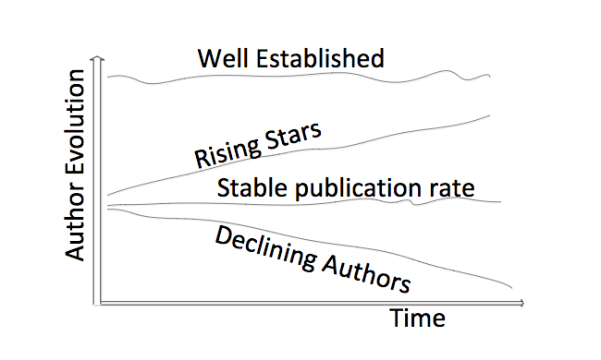

PROBLEM DEFINITION
Analyze the trends and patterns behind KOL
Predict the probability of an individual to be KOL
$$∇P$$
Rising Stars
Declining Authors
Well Established
Production P
FIG: Four basic author’s evolution behavior over time (Tsatsaronis et al. 2011)

Slide 3
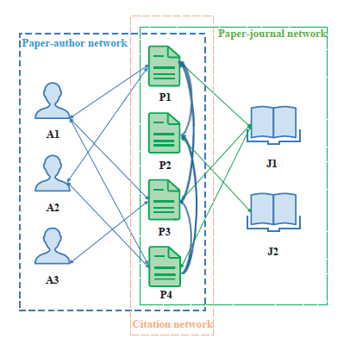
State of Art
PageRank
Supervised Learning
Clustering

Slide 4
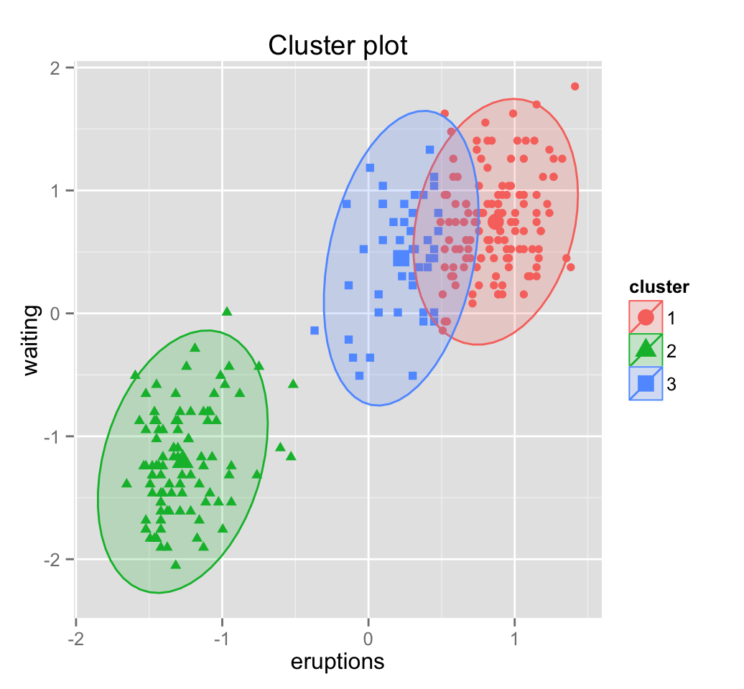
Methodology
KOL
Indices
Rising stars
Absence of manually annotated data
Unsupervised Learning: Clustering
3 steps:
Define features
Monitor the evolution of features
Use these indices to cluster authors
Non-KOL
Time
Notes:
Supervised learning is not applicable due to the absence of manually annotated data(rising stars) for this task

Slide 5
Data Preprocessing
Original variables/features
13 tables
Address
Affiliation
Events
Profile
Education
Press
Publication
Around 100 variables

Slide 6
Data Preprocessing
Derivative variables/features
HBE Universal Code
Publication Year
Article Title
Journal Name
Journal H-index
Position
Author List

Slide 7
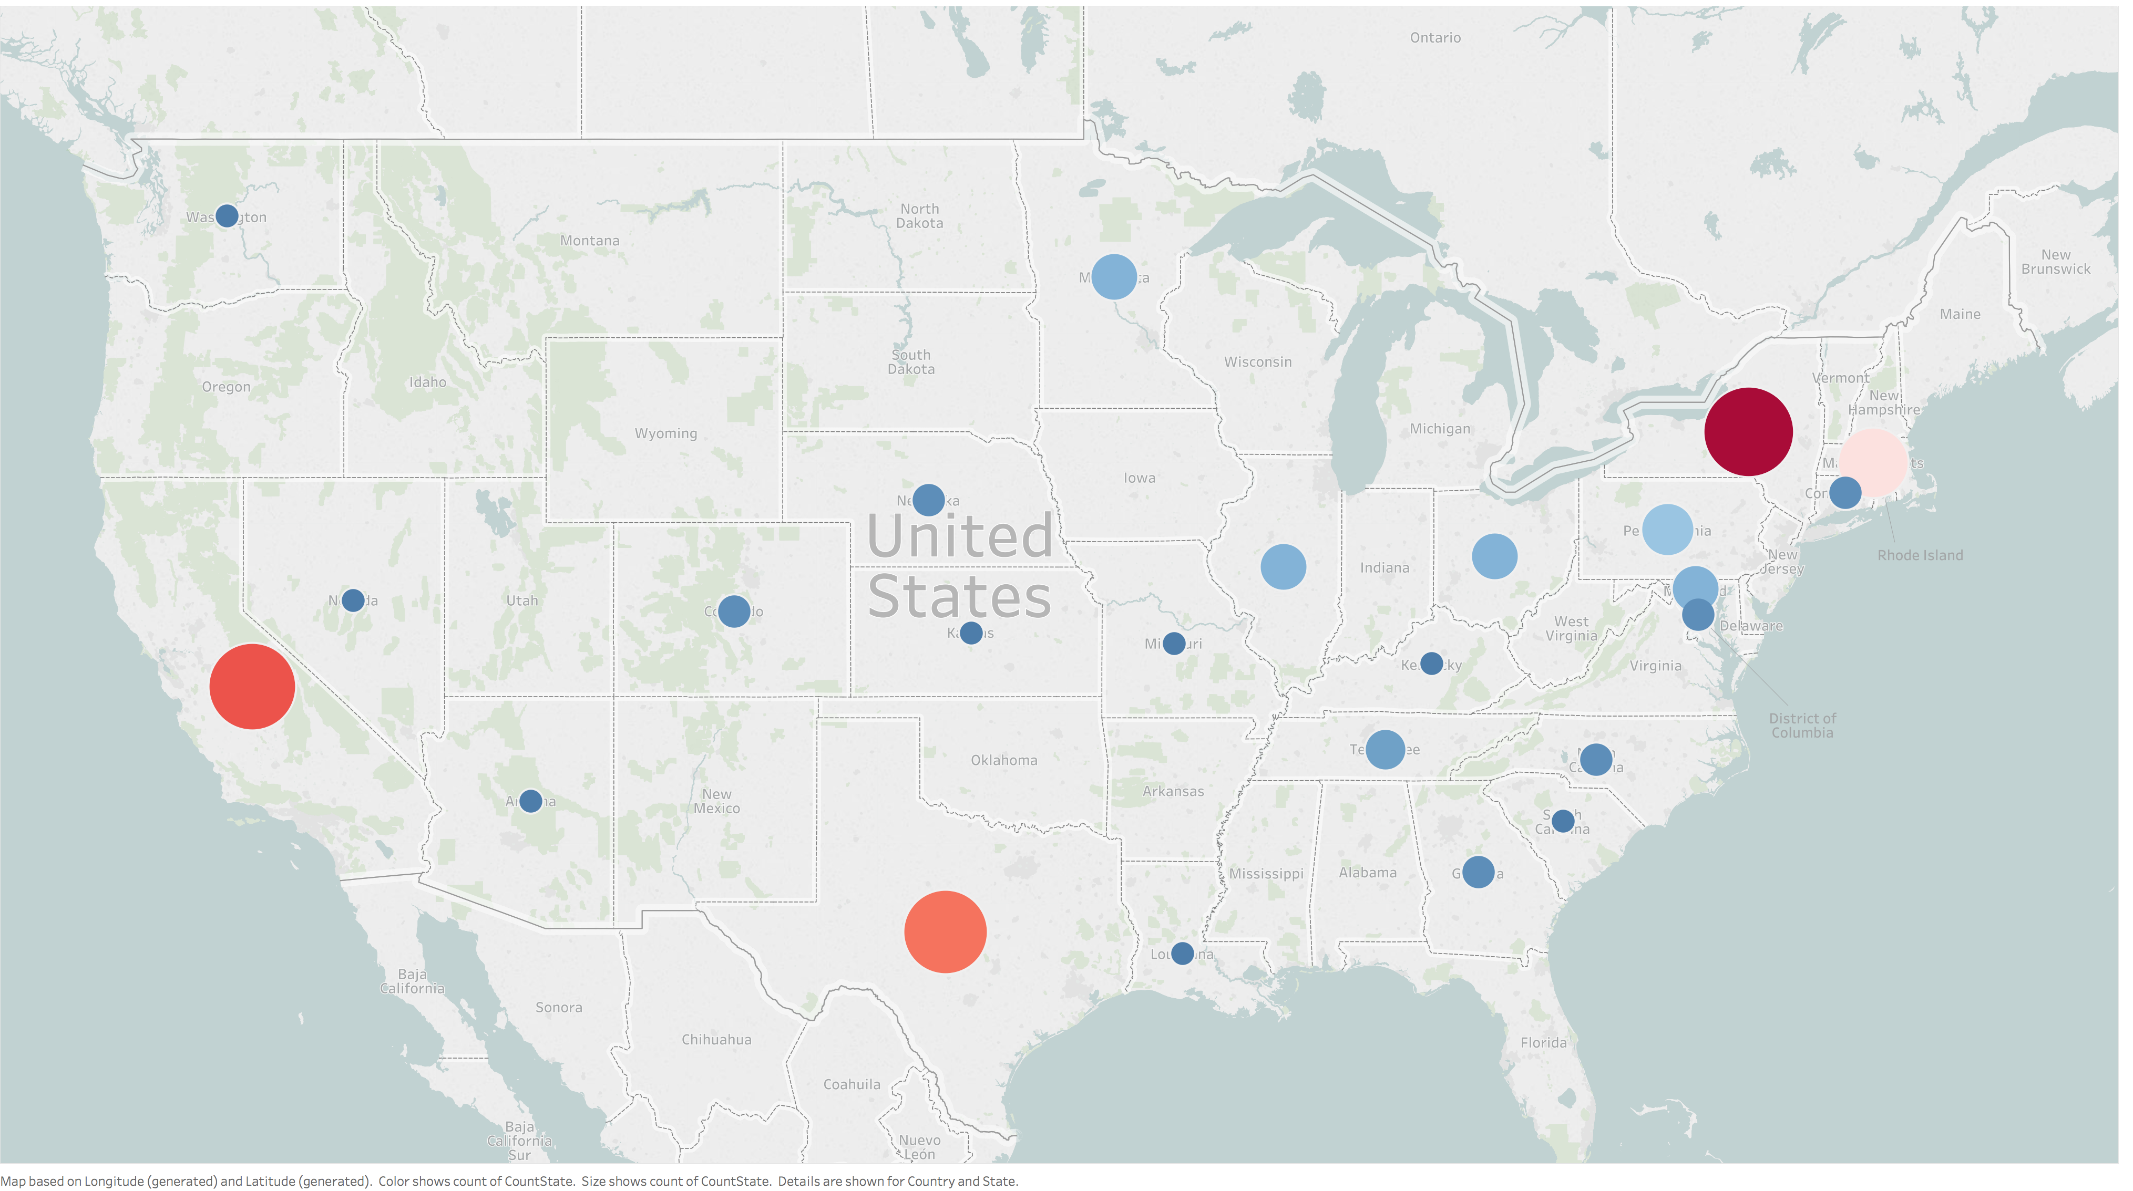
KOL's geographic distribution

Slide 8
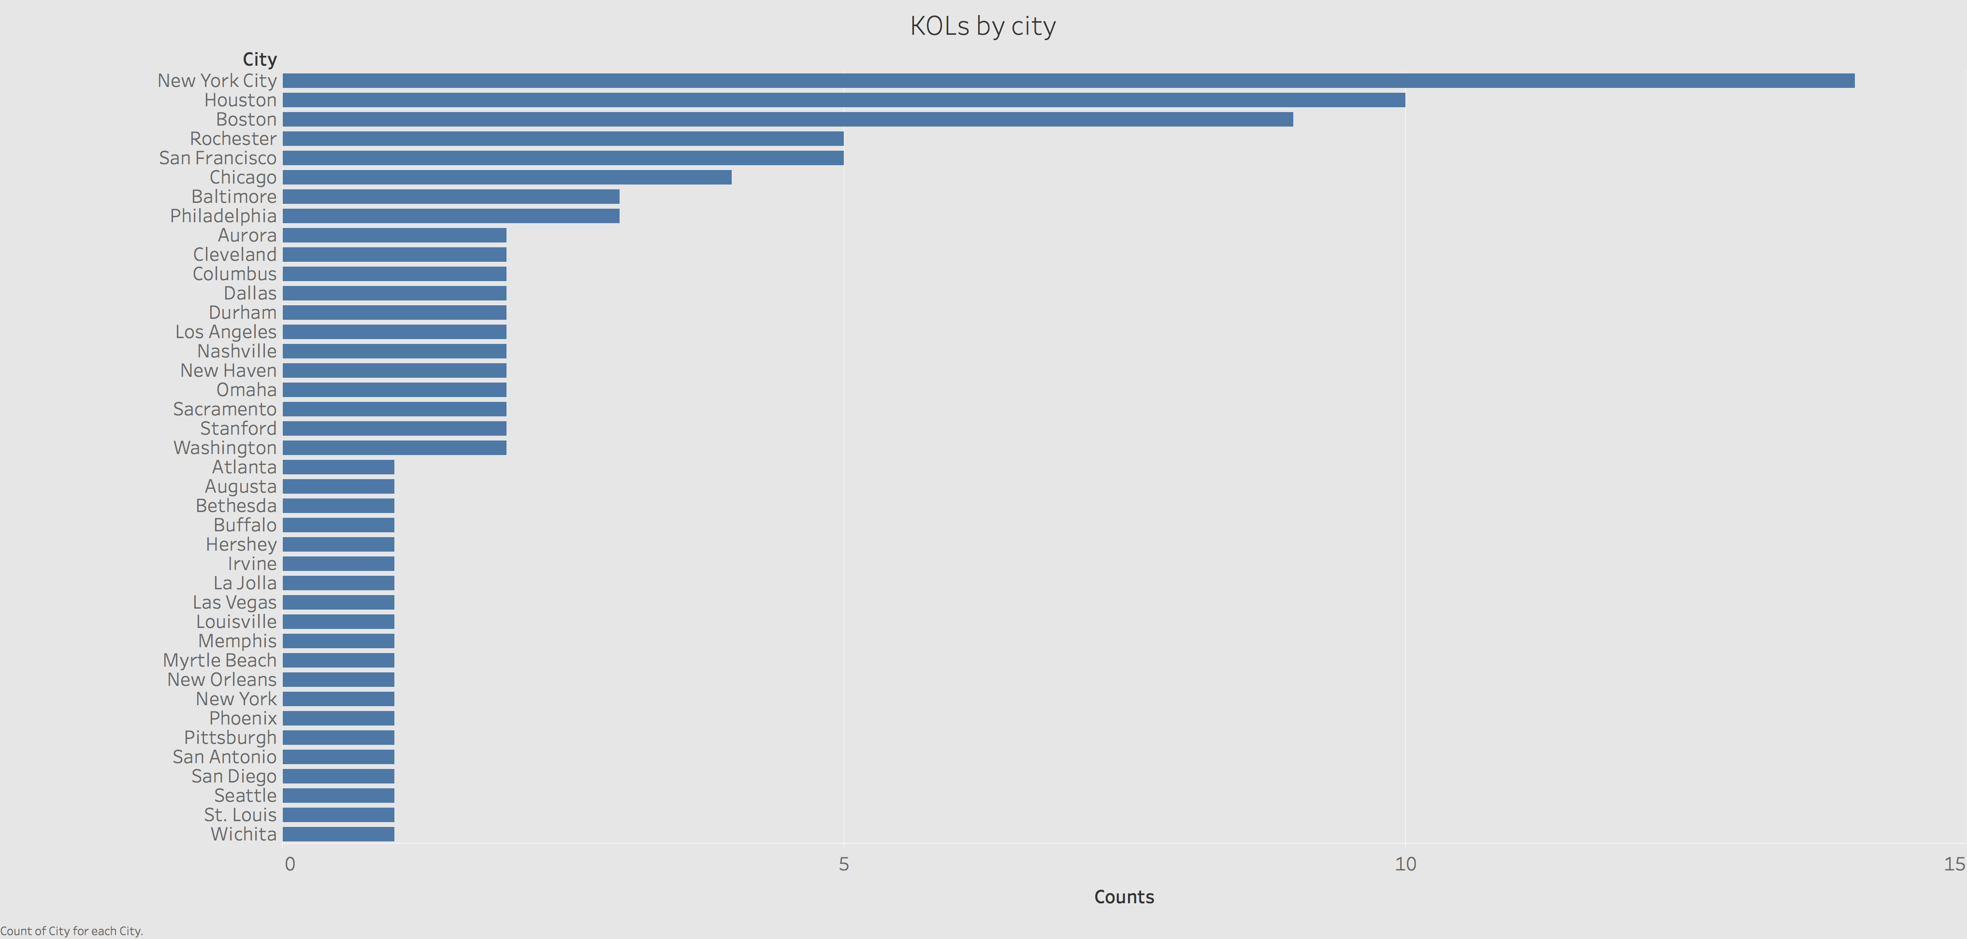

Slide 9
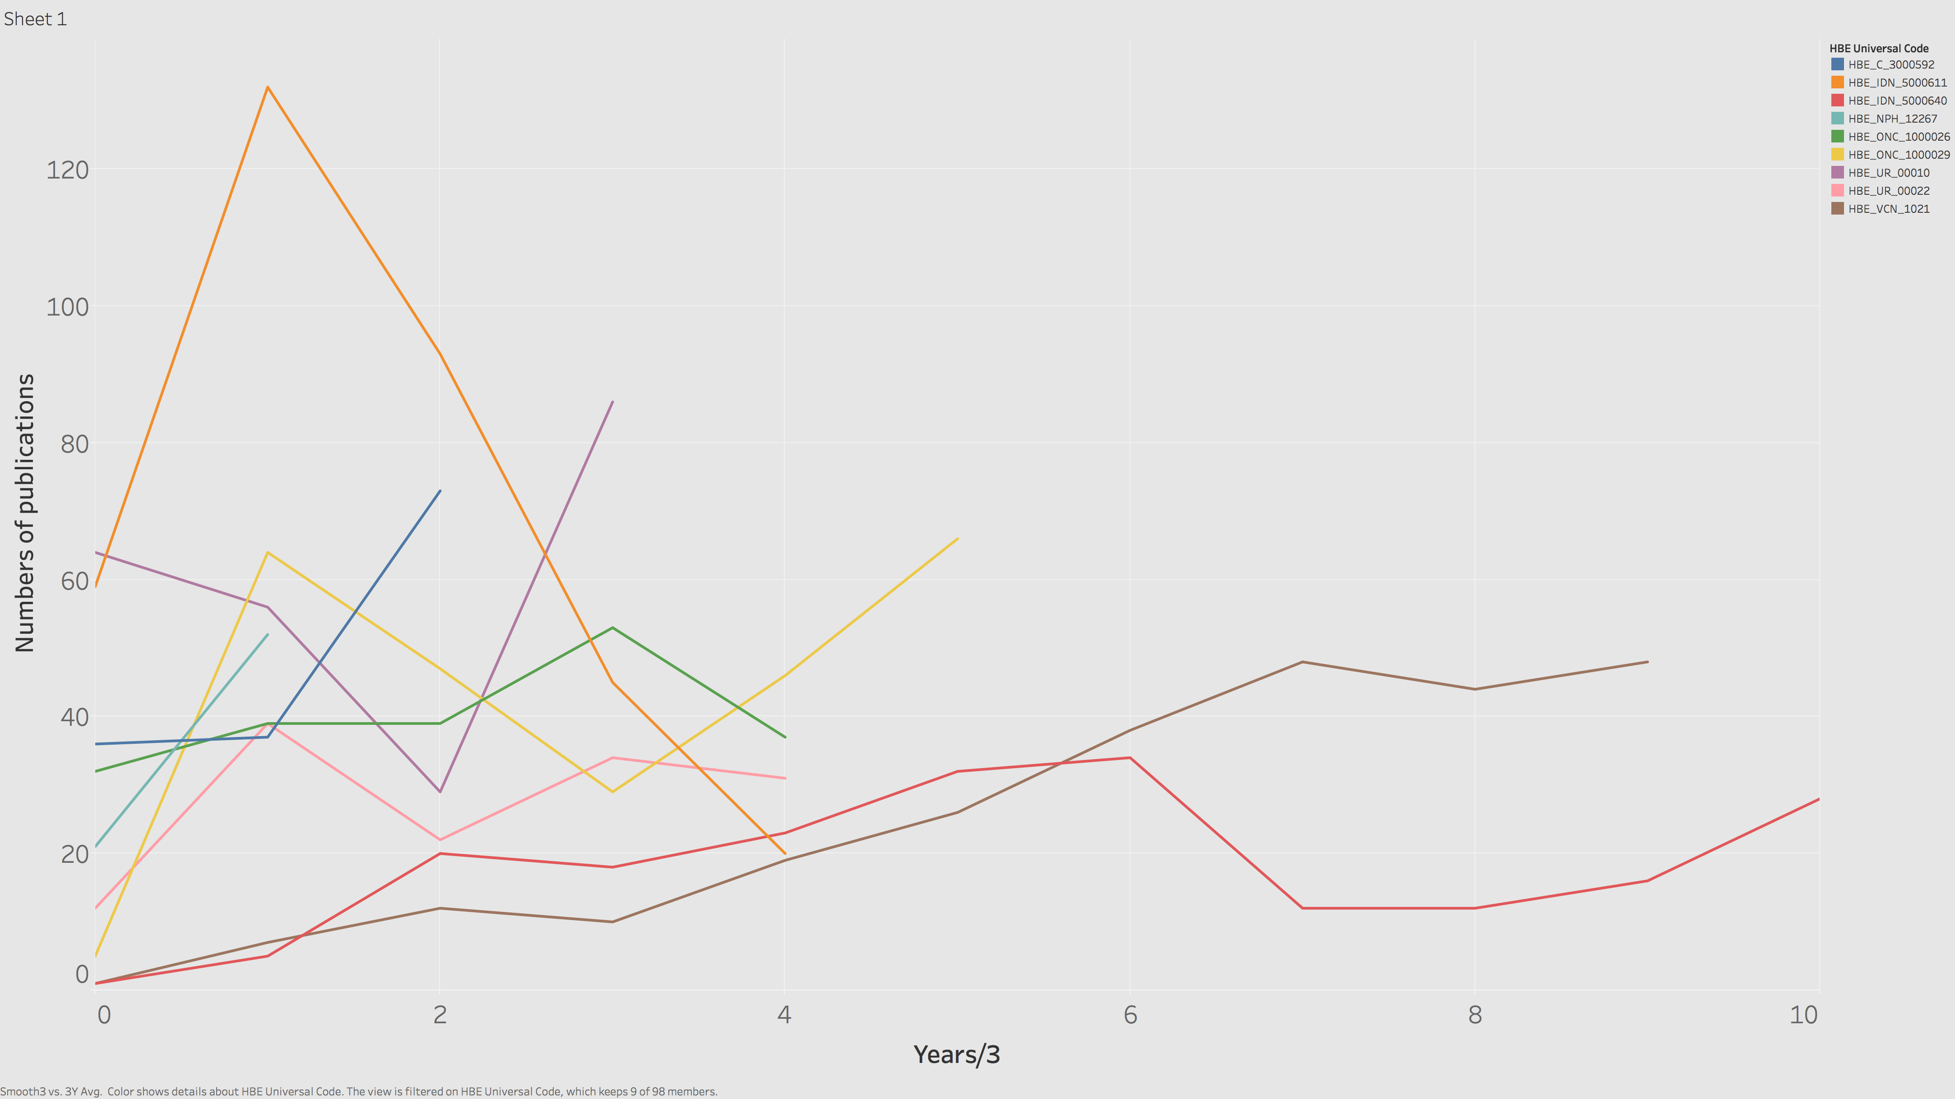
Production evolution of KOLs

Slide 10
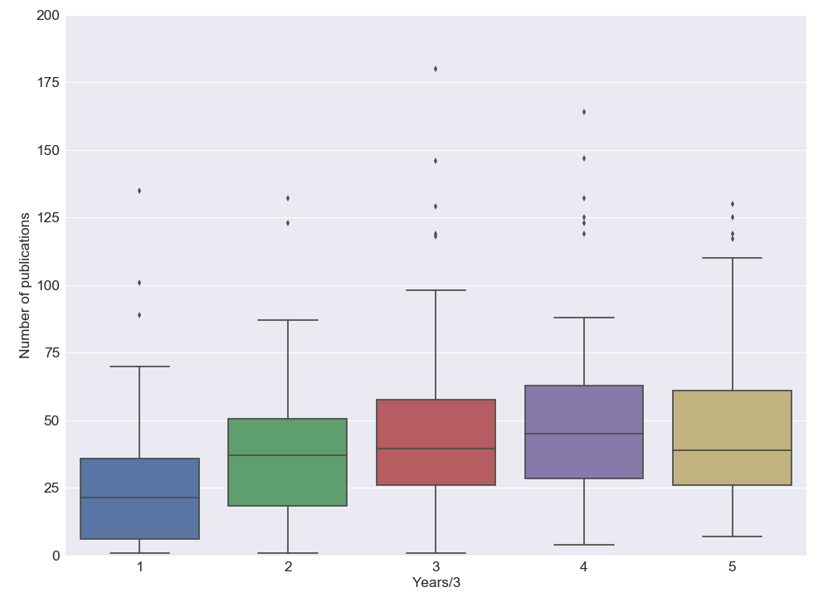
Production stats in early career
Years/3 | 1 | 2 | 3 | 4 | 5
count | 98 | 94 | 94 | 83 | 62
mean | 25.45 | 39.71 | 48.49 | 53.81 | 60.42
std | 24.23 | 33.15 | 46.36 | 44.79 | 67.88
min | 1 | 1 | 1 | 4 | 7
25% | 6.25 | 18.5 | 26 | 28.5 | 26
50% | 21.5 | 37 | 39.5 | 45 | 39
75% | 35.75 | 50.5 | 57.75 | 63 | 61
max | 135 | 246 | 381 | 285 | 420

Slide 11
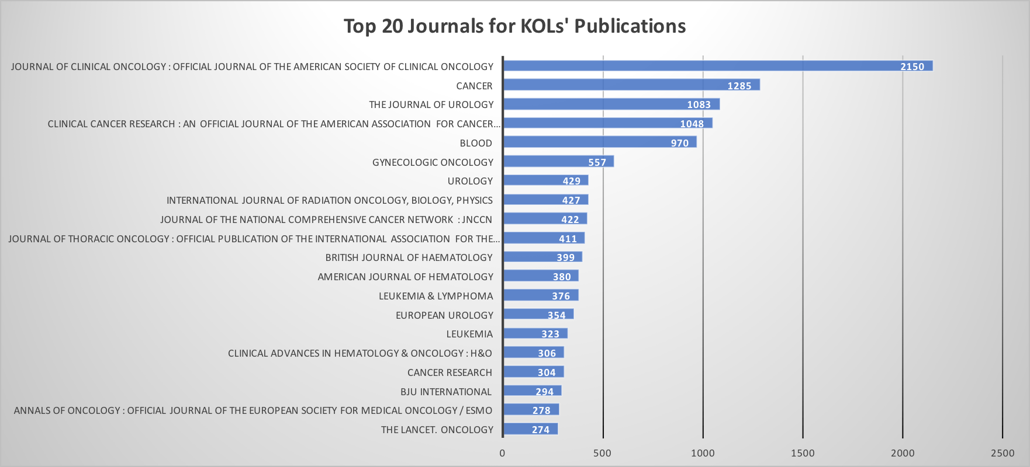
Publication Journals Analysis
Top 20 journals account for 47.50% publications

Slide 12
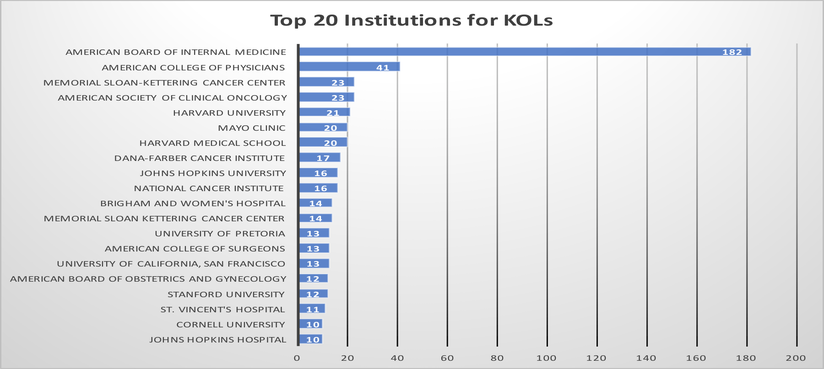
Education Institution Analysis
Top 20 institutions account for 39.67% admissions

Slide 13
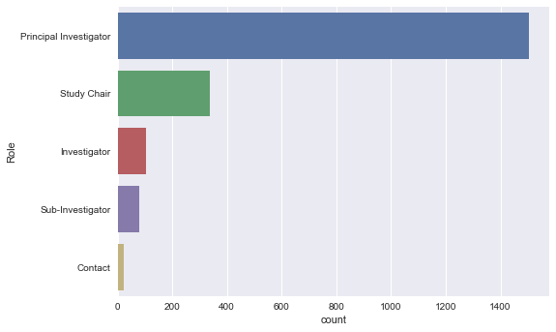
Exploratory Data Analysis

Slide 14
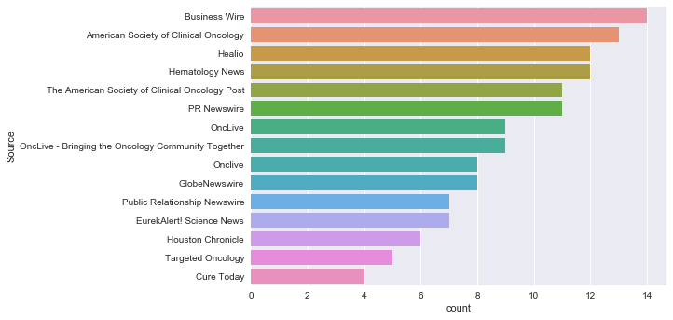
Exploratory Data Analysis

Slide 15
Extracting citation information
Why does citation information make sense
Demonstrate the impact of the work
Reveal coauthor network
Method
Web scraping from Google Scholar
Scopus API
PubMed
Tech issue

Slide 16
Next steps
Want 100 samples
Feature engineering
Build models
Prediction and validation
Citation(option)
Obtained 100 samples
Want 100 samples
FIG: Four basic author’s evolution behavior over time (Tsatsaronis et al. 2011)

